Slide 1
Rotational Motion
Physics
Unit 4
Notes:
Physics Unit 4

Slide 2
This Slideshow was developed to accompany the textbook
  OpenStax Physics
    Available for free at https://openstaxcollege.org/textbooks/college-physics
  By OpenStax College and Rice University
  2013 edition
Some examples and diagrams are taken from the textbook.
Slides created by
Richard Wright, Andrews Academy
rwright@andrews.edu

Slide 3
04-01 Equilibrium
In this lesson you will…
• State the first condition of equilibrium.
• Explain static equilibrium.
• Explain dynamic equilibrium.
• State the second condition that is necessary to achieve equilibrium.
• Explain torque and the factors on which it depends.
• Describe the role of torque in rotational mechanics.

Slide 4
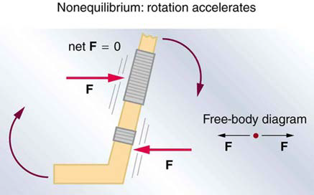

04-01 Equilibrium
Statics
  Study of forces in equilibrium
  Equilibrium means no acceleration
First condition of equilibrium
  $net F=0$
    $F_{x}=0$ and $F_{y}=0$
    They can still rotate, so…

Slide 5
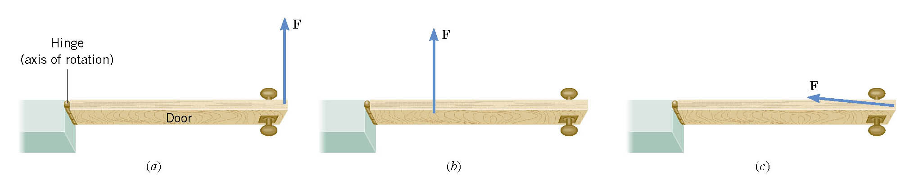

04-01 Equilibrium
Think of opening a door
Which opens the door the best?
  Picture a
Big force → large torque
Force away from pivot → large torque
Force directed $⊥$ to door → large torque

Slide 6
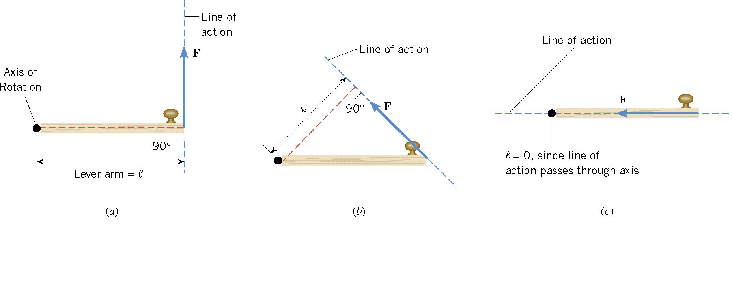
04-01 Equilibrium
τ = F × r
  This means we use the component of the force that is perpendicular to the lever arm
τ = F⊥ r
τ = F r sin θ
  θ is the angle between the force and the radius
Unit: Nm
  CCW → +
  CW → -

Slide 7
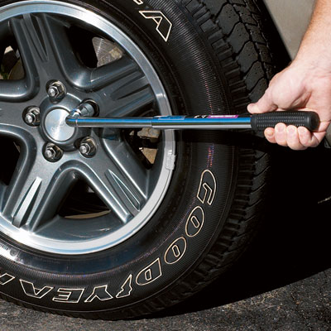
04-01 Equilibrium
You are meeting the parents of your new “special” friend for the first time. After being at their house for a couple of hours, you walk out to discover the little brother has let all the air out of one of your tires. Not knowing the reason for the flat tire, you decide to change it. You have a 50-cm long lug-wrench attached to a lugnut as shown. If 900 Nm of torque is needed, how much force is needed?
F = 2078 N
Less force required if pushed at 90°
120°
Notes:
$$τ=Fr\sin{θ}$$
$$900 Nm=F(0.5m)(\sin{120°})$$
$$F=2078 N$$

Slide 8
04-01 Equilibrium
Second condition of equilibrium
  Net torque = 0

Slide 9
04-01 Equilibrium
A 5 m, 10 kg seesaw is balanced by a little girl (25 kg) and her father (80 kg) at opposite ends as shown below. How far from the seesaw’s center of mass must the fulcrum be placed?
  1.20 m
How much force
must the fulcrum
support?
  1029 N
80 kg
25 kg
x m
10 kg
5 m
Notes:
$$∑τ=0$$
$$\left(25 kg⋅9.8 m/s^{2}\right)\left(2.5 m+x\right)+\left(10 kg⋅9.8 m/s^{2}\right)x−\left(80 kg⋅9.8 m/s^{2}\right)\left(2.5 m−x\right)=0$$
$$612.5 Nm+245 N x+98 N x−1960 Nm+784 N x=0$$
$$−1347.5 Nm+1127 N x=0$$
$$1127 N x=1347.5 Nm$$
$$x=1.20 m$$
$$∑F=−W_{g}−W_{f}+F_{f}=0$$
$$−\left(25 kg\right)\left(9.8\frac{m}{s^{2}}\right)−\left(80 kg\right)\left(9.8\frac{m}{s^{2}}\right)+F_{f}=0$$
$$−1029 N+F_{f}=0$$
$$F_{f}=1029 N$$

Slide 10
04-01 Homework
Twist out the answers to these torque questions
Read 9.3, 9.4

Slide 11
04-02 Stability and Applications
In this lesson you will…
• State the types of equilibrium.
• Describe stable and unstable equilibriums.
• Describe neutral equilibrium.
• Discuss the applications of Statics in real life.
• State and discuss various problem-solving strategies in Statics.

Slide 12
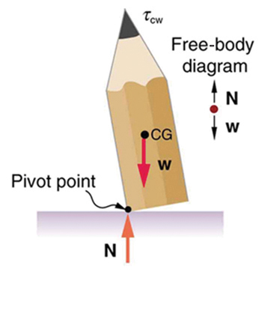
04-02 Stability and Applications
Stable equilibrium
  When displaced from equilibrium, the system experiences a net force or torque in a direction opposite to the direction of the displacement.

Slide 13
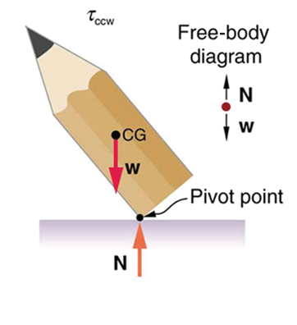
04-02 Stability and Applications
Unstable equilibrium
  When displaced from equilibrium, the net force or torque is in same direction of the displacement

Slide 14
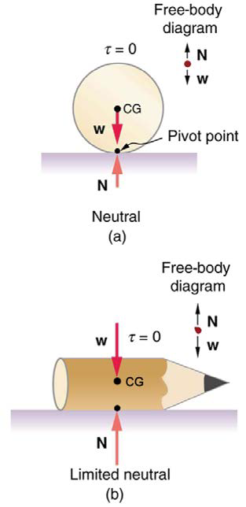
04-02 Stability and Applications
Neutral Equilibrium
  Equilibrium is independent of displacement from its original position

Slide 15

04-02 Stability and Applications
Problem-Solving Strategy for Static Equilibrium
Is it in equilibrium? (no acceleration or accelerated rotation)
Draw free body diagram
Apply $∑F=0$ and/or $∑τ=0$
  Choose a pivot point to simplify the problem
Check your solution for reasonableness.

Slide 16
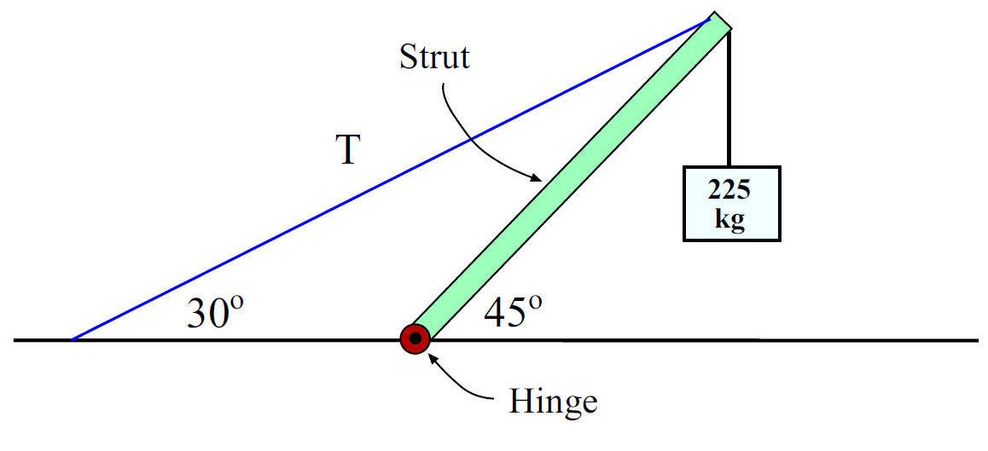
04-02 Stability and Applications
The system is in equilibrium. A mass of 225 kg hangs from the end of the uniform strut whose mass is 45.0 kg. Find (a) the tension T in the cable and the (b) horizontal and (c) vertical force components exerted on the strut by the hinge.
Free body
diagram
next slide

Slide 17
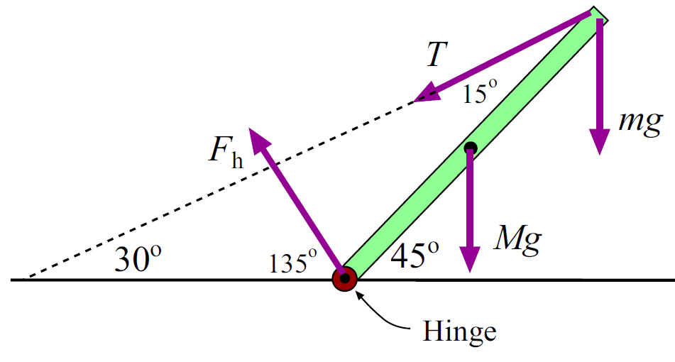

04-02 Stability and Applications
$m=225 kg, M=45.0 kg,T= ?, F_{hx}= ?, F_{hy}= ?$
$T=6627 N$
$F_{hx}=5739 N$
$F_{hy}=5959 N$
Notes:
Use hinge as pivot point to eliminate need for $F_{h}$
$$∑τ=0$$
$$F_{h}\left(0\right)+T\left(L\right)\sin{15°}−\left(Mg\right)\left(\frac{L}{2}\right)\sin{45°}−mg\left(L\right)\sin{45°}=0$$
$$0+TL\sin{15°}−\left(45 kg\right)\left(9.8\frac{m}{s^{2}}\right)\left(\frac{L}{2}\right)sin 45°−\left(225 kg\right)\left(9.8\frac{m}{s^{2}}\right)\left(L\right)\sin{45°}=0$$
$$TL\sin{15°}−155.917 N L−1559.170 N L=0$$
$$TL\sin{15°}=1715.087 N L$$
$$T=\frac{1715.087 N}{\sin{15°}}=6627 N$$
Find $F_{hx}$
$$∑F_{x}=0$$
$$F_{hx}−T\cos{30°}+0+0=0$$
$$F_{hx}=6627 N\cos{30°}=5739 N$$
Find $F_{hy}$
$$∑F_{y}=0$$
$$F_{hy}−T\sin{30°}−Mg−mg=0$$
$$F_{hy}=T\sin{30°}+Mg+mg$$
$$F_{hy}=6627 N\sin{30°}+\left(45 kg\right)\left(9.8\frac{m}{s^{2}}\right)+\left(225 kg\right)\left(9.8\frac{m}{s^{2}}\right)=5959 N$$

Slide 18
04-02 Homework
Pick a stable position while you apply your knowledge.
Read 9.5, 9.6

Slide 19
04-03 Simple Machines, Muscles, and Joints
In this lesson you will…
• Describe different simple machines.
• Calculate the mechanical advantage.
• Explain the forces exerted by muscles.
• State how a bad posture causes back strain.
• Discuss the benefits of skeletal muscles attached close to joints.
• Discuss various complexities in the real system of muscles, bones, and joints.

Slide 20

04-03 Simple Machines, Muscles, and Joints
Machines make work easier
  Energy is conserved so same amount of energy with or without machine
Mechanical Advantage (MA)
  $MA=\frac{F_{o}}{F_{i}}$
Notes:
$$F_{o}=force out$$
$$F_{i}=force in$$

Slide 21
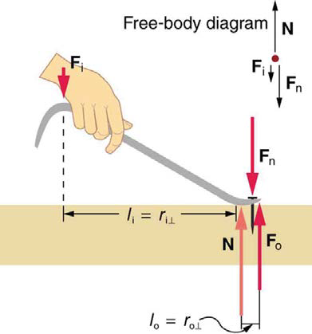

04-03 Simple Machines, Muscles, and Joints
Lever
Uses torques with pivot at N
$F_{i}l_{i}=F_{o}l_{o}$
$\frac{F_{o}}{F_{i}}=\frac{l_{i}}{l_{o}}$
When F $↑$, $l↓$
$MA=\frac{F_{o}}{F_{i}}=\frac{d_{i}}{d_{o}}$

Slide 22
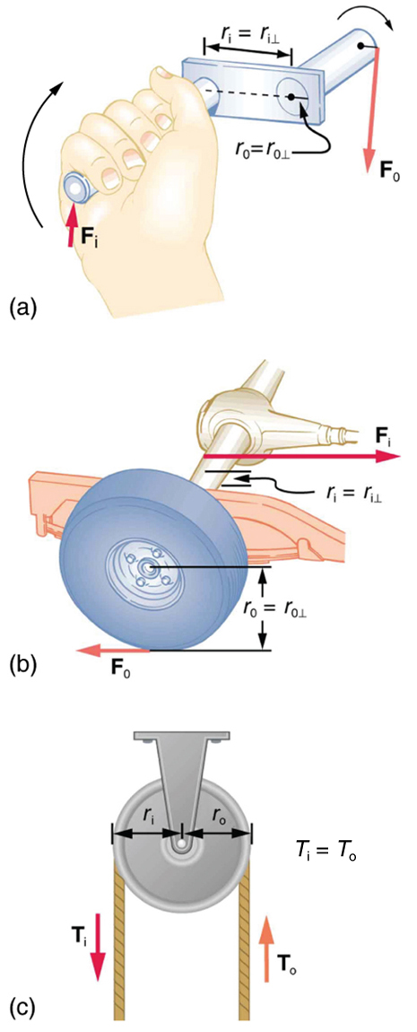
04-03 Simple Machines, Muscles, and Joints
Other simple machines
Wheel and Axle
  Lever
Inclined Plane
  Ramp – less force to slide up, but longer distance
Screw
  Inclined plane wrapped around a shaft
Wedge
  Two inclined planes

Slide 23
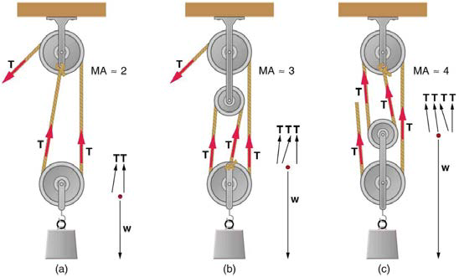
04-03 Simple Machines, Muscles, and Joints
Pulley
  Grooved wheel
  Changed direction of force
  In combination, can decrease force

Slide 24
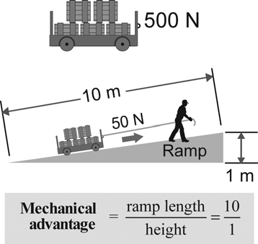

04-03 Simple Machines, Muscles, and Joints
What is the mechanical advantage of the inclined plane?
MA = 10
What is the weight of the cart assuming no friction?
$F_{o}=500$ N
Notes:
$$MA=\frac{F_{o}}{F_{i}}=\frac{d_{i}}{d_{o}}$$
$$MA=\frac{10 m}{1 m}=10$$
$$\frac{F_{o}}{50 N}=\frac{10 m}{1 m}$$
$$F_{o}=500 N$$

Slide 25
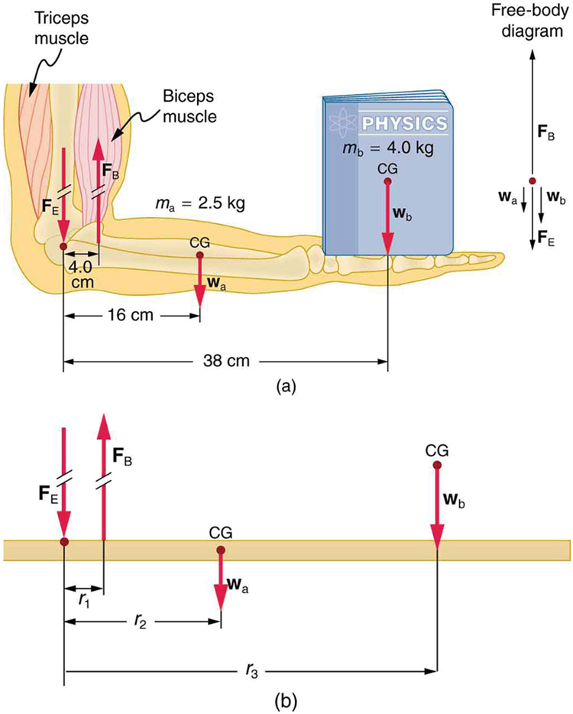
04-03 Simple Machines, Muscles, and Joints
Muscles only contract, so they come in pairs
Muscles are attached to bones close to the joints using tendons
This makes the muscles supply larger force than is lifted
Input force > output force
MA < 1
Notes:
Huge forces can be created this way.

Slide 26
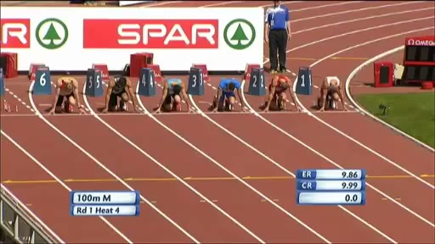

Slide 27
04-03 Homework
Machines can’t help you much here, exercise your mental muscles instead
Read 10.1, 10.2

Slide 28
04-04 Kinematics of Rotational Motion
In this lesson you will…
• Describe uniform circular motion.
• Explain non-uniform circular motion.
• Calculate angular acceleration of an object.
• Observe the link between linear and angular acceleration.
• Observe the kinematics of rotational motion.
• Derive rotational kinematic equations.
• Evaluate problem solving strategies for rotational kinematics.

Slide 29

04-04 Kinematics of Rotational Motion
Rotational motion
Describes spinning motion
$θ$ is like x
  $x=rθ$ → position
$ω$ is like v
  $ω=\frac{Δθ}{Δt}$
  $v=rω$ → velocity
$α$ is like a
  $α=\frac{Δω}{Δt}$
  $a_{t}=rα$ → acceleration
Notes:
CCW is +
CW is -

Slide 30
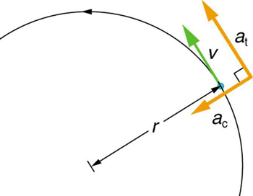


04-04 Kinematics of Rotational Motion
Two components to acceleration
  Centripetal
    Toward center
    Changes direction only since perpendicular to v
    $a_{c}=\frac{v^{2}}{r}$
Tangental (linear)
  Tangent to circle
  Changes speed only since parallel to v
  $a_{t}=rα$

Slide 31

04-04 Kinematics of Rotational Motion
Equations of kinematics for rotational motion are same as for linear motion
$θ=\overline{ω}t$
$ω=ω_{0}+αt$
$θ=ω_{0}t+\frac{1}{2}αt^{2}$
$ω^{2}=ω_{0}^{2}+2αθ$

Slide 32
04-04 Kinematics of Rotational Motion
Reasoning Strategy
Examine the situation to determine if rotational motion involved
Identify the unknowns (a drawing can be useful)
Identify the knowns
Pick the appropriate equation based on the knowns/unknowns
Substitute the values into the equation and solve
Check to see if your answer is reasonable

Slide 33
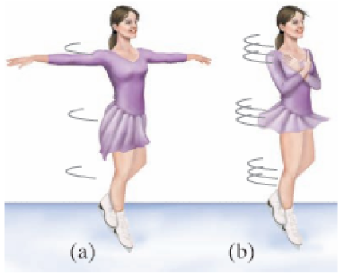
04-04 Kinematics of Rotational Motion
A figure skater is spinning at 0.5 rev/s and then pulls her arms in and increases her speed to 10 rev/s in 1.5 s. What was her angular acceleration?
39.8 rad/s²
Notes:
$$ω_{0}=0.5\frac{rev}{s} \left(\frac{2π rad}{rev}\right)=π\frac{rad}{s}$$
$$ω=10\frac{rev}{s}\left(\frac{\left(2π rad\right)}{rev}\right)=20π\frac{rad}{s}$$
$$t=1.5 s$$
$$ω=ω_{0}+αt$$
$$20π\frac{rad}{s}=π\frac{rad}{s}+α\left(1.5 s\right)$$
$$19π\frac{rad}{s}=α\left(1.5 s\right)$$
$$α=39.8\frac{rad}{s^{2}}$$

Slide 34
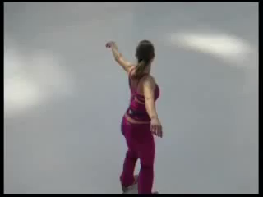

Slide 35
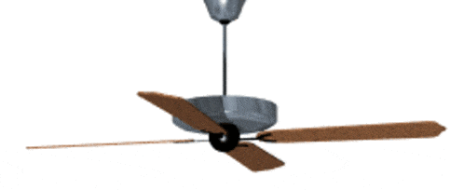

04-04 Kinematics of Rotational Motion
A ceiling fan has 4 evenly spaced blades of negligible width. As you are putting on your shirt, you raise your hand. It brushes a blade and then is hit by the next blade. If the blades were rotating at 4 rev/s and stops in 0.01 s as it hits your hand, what angular displacement did the fan move after it hit your hand?
$θ=0.02 rev=0.126 rad=7.2°$
Notes:
$$ω_{0}=4\frac{rev}{s}, t=0.01 s$$
$$θ=\overline{ω}t$$
$$θ=\left(\frac{ω+ω_{0}}{2}\right)t$$
$$θ=\left(\frac{0+4\frac{rev}{s}}{2}\right)\left(0.01 s\right)=0.02 rev=0.126 rad=7.2°$$

Slide 36
04-04 Homework
Spin up your mind and toss out some answers
Read 10.3, 10.4

Slide 37
04-05 Dynamics of Rotational Motion
In this lesson you will…
• Understand the relationship between force, mass and acceleration.
• Study the turning effect of force.
• Study the analogy between force and torque, mass and moment of inertia, and linear acceleration and angular
acceleration.
• Derive the equation for rotational work.
• Calculate rotational kinetic energy.
• Demonstrate the Law of Conservation of Energy.

Slide 38
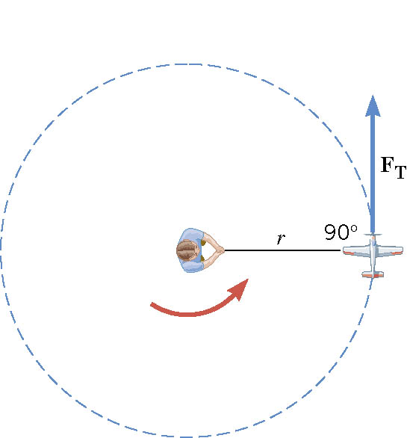

04-05 Dynamics of Rotational Motion
$τ=F_{T}r$
  $F_{T}=ma_{t}$
$τ=ma_{t}r$
  $a_{t}=rα$
$τ=mr^{2}α$
  $I=mr^{2}$ → Moment of inertia of a particle
$τ=Iα$
  Newton’s second law for rotation
  α is in rad/s²

Slide 39
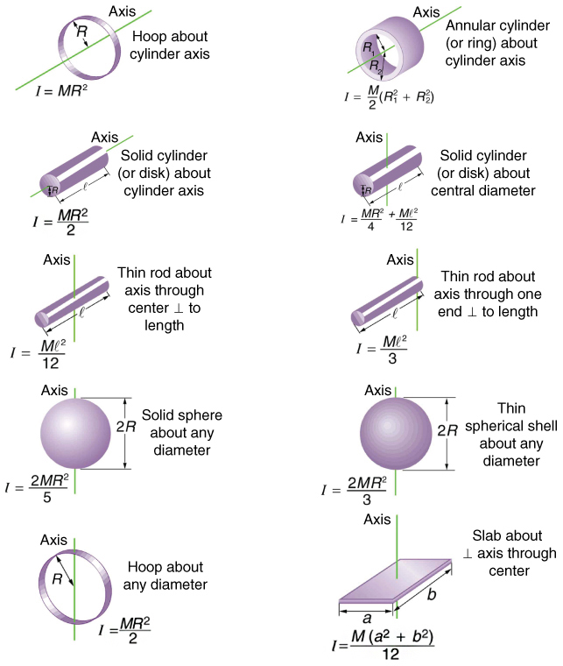

04-05 Dynamics of Rotational Motion
Moment of Inertia (I) measures how much an object wants to keep rotating (or not start rotating)
Use calculus to find $I=∑mr^{2}$
Unit:
  kg m²
Page 328 lists I for many different mass distributions

Slide 40


04-05 Dynamics of Rotational Motion
Work for rotation
  $W=FΔs$
  $W=Fr\frac{Δs}{r}$
  $W=τθ$
Kinetic Energy
  $KE_{rot}=\frac{1}{2}Iω^{2}$
Conservation of Mechanical Energy
  $PE_{i}+KE_{i}=PE_{f}+KE_{f}$
  Remember that the KE can include both translational and rotational.
Notes:
$$KE=\frac{1}{2}mv^{2}$$
I is the same as m for rotation
Conservation of ME is when closed system

Slide 41

04-05 Dynamics of Rotational Motion
Zorch, an archenemy of Superman, decides to slow Earth’s rotation to once per 28.0 h by exerting an opposing force at and parallel to the equator. Superman is not immediately concerned, because he knows Zorch can only exert a force of 4.00×10⁷ N (a little greater than a Saturn V rocket’s thrust). How long must Zorch push with this force to accomplish his goal? (This period gives Superman time to devote to other villains.)
$1.26×{10}^{11} yr$
Notes:
$$F=−4×{10}^{7} N, r=6.38×{10}^{6} m, m_{E}=5.98×{10}^{24} kg$$
$$ω_{0}=\frac{1 rev}{24 h}\left(\frac{2π rad}{1 rev}\right)\left(\frac{1 h}{3600 s}\right)=\frac{π}{43200}\frac{rad}{s}≈7.272×{10}^{−5}\frac{rad}{s}$$
$$w_{f}=\frac{1 rev}{28 h}\left(\frac{2π}{1 rev}\right)\left(\frac{1 h}{3600 s}\right)=\frac{π}{50400}\frac{rad}{s}≈6.233×{10}^{−5}\frac{rad}{s}$$
$$τ=Iα$$
$$α=\frac{Δω}{Δt}=\frac{ω_{f}−ω_{0}}{t}$$
$$τ=I\left(\frac{ω_{f}−ω_{0}}{t}\right)$$
$$t=\frac{I\left(ω_{f}−ω_{0}\right)}{τ}$$
$$I=\frac{2}{5}MR^{2}, τ=FR$$
$$t=\frac{\frac{2}{5}MR^{2}\left(ω_{f}−ω_{0}\right)}{FR}$$
$$t=\frac{2\left(5.98×{10}^{24} kg\right)\left(6.38×{10}^{6} m\right)\left(6.233×{10}^{−5}\frac{rad}{s}−7.272×{10}^{−5}\frac{rad}{s}\right)}{5\left(−4.00×{10}^{7} N\right)}$$
$$t=3.964×{10}^{18} s=1.101×{10}^{15} h=4.588×{10}^{13} d=1.26×{10}^{11} yr$$

Slide 42
04-05 Dynamics of Rotational Motion
A solid sphere (m = 2 kg and r = 0.25 m) and a thin spherical shell (m = 2 kg and r = 0.25 m) roll down a ramp that is 0.5 m high. What is the velocity of each sphere as it reaches the bottom of the ramp?
Solid: 2.65 m/s
Shell: 2.42 m/s
Notice masses canceled so mass didn’t matter
Notes:
Solid Sphere: $m=2 kg, r=0.25 m, h_{0}=0.5 m, h_{f}=0, v_{0}=0, ω_{0}=0$
$$PE_{i}+KE_{trans0}+KE_{rot0}=PE_{f}+KE_{transf}+KE_{rotf}$$
$$mgh_{0}+0+0=0+\frac{1}{2}mv_{f}^{2}+\frac{1}{2}Iω_{f}^{2}$$
$$mgh_{0}=\frac{1}{2}mv_{f}^{2}+\frac{1}{2}\left(\frac{2}{5}mr^{2}\right)ω_{f}^{2}$$
$$gh_{0}=\frac{1}{2}v_{f}^{2}+\frac{1}{5}r^{2}{\left(\frac{v_{f}}{r}\right)}^{2}$$
$$gh_{0}=\frac{1}{2}v_{f}^{2}+\frac{1}{5}v_{f}^{2}$$
$$gh_{0}=\frac{7}{10}v_{f}^{2}$$
$$v_{f}=\sqrt{\frac{10}{7}gh_{0}}$$
$$v_{f}=\sqrt{\frac{10}{7}\left(9.80\frac{m}{s^{2}}\right)\left(0.5 m\right)}=2.65\frac{m}{s}$$
Shell: $m=2 kg, r=0.25 m, h_{0}=0.5 m, h_{f}=0, v_{0}=0, ω_{0}=0$
$$PE_{i}+KE_{trans0}+KE_{rot0}=PE_{f}+KE_{transf}+KE_{rotf}$$
$$mgh_{0}+0+0=0+\frac{1}{2}mv_{f}^{2}+\frac{1}{2}Iω_{f}^{2}$$
$$mgh_{0}=\frac{1}{2}mv_{f}^{2}+\frac{1}{2}\left(\frac{2}{3}mr^{2}\right)ω_{f}^{2}$$
$$gh_{0}=\frac{1}{2}v_{f}^{2}+\frac{1}{3}r^{2}{\left(\frac{v_{f}}{r}\right)}^{2}$$
$$gh_{0}=\frac{1}{2}v_{f}^{2}+\frac{1}{3}v_{f}^{2}$$
$$gh_{0}=\frac{5}{6}v_{f}^{2}$$
$$v_{f}=\sqrt{\frac{6}{5}gh_{0}}$$
$$v_{f}=\sqrt{\frac{6}{5}\left(9.80\frac{m}{s^{2}}\right)\left(0.5 m\right)}=2.42\frac{m}{s}$$

Slide 43
04-05 Homework
Don’t spin your wheels as you use energy to solve these problems
Read 10.5

Slide 44
04-06 Angular Momentum
In this lesson you will…
• Understand the analogy between angular momentum and linear momentum.
• Observe the relationship between torque and angular momentum.
• Apply the law of conservation of angular momentum.

Slide 45

04-06 Angular Momentum
Linear momentum
  p = mv
Angular momentum
  L = Iω
  Unit:
  kg m²/s
  ω must be in rad/s
When you rotate something you exert a torque.
More torque = faster change in angular momentum
$τ_{net}=\frac{ΔL}{Δt}$
Like $F=\frac{Δp}{Δt}$
Notes:
Demo with the rotation rods
I is like m for rotational motion

Slide 46

04-06 Angular Momentum
Linear momentum of a system is conserved if $F_{net}=0$
  p₀ = p_{f}
Angular momentum of a system is also conserved if $τ_{net}=0$
  L₀ = L_{f}

Slide 47

04-06 Angular Momentum
A 10-kg solid disk with r = 0.40 m is spinning at 8 rad/s. A 9-kg solid disk with r = 0.30 m is dropped onto the first disk. If the first disk was initially not rotating, what is the angular velocity after the disks are together?
  ω = 5.31 rad/s
What was the torque applied by the first disk onto the second if the collision takes 0.01 s?
  $τ$ = 215 Nm
Notes:
Disk 1:
$$ω_{0}=8\frac{rad}{s}, r=0.4 m, m=10 kg$$
$$I=\frac{1}{2}MR^{2}=\frac{1}{2}\left(10 kg\right){\left(0.4 m\right)}^{2}=0.8 kg⋅m^{2}$$
Disk 2:
$$ω_{0}=0\frac{rad}{s}, r=0.3 m, m=9 kg$$
$$I=\frac{1}{2}MR^{2}=\frac{1}{2}\left(9 kg\right){\left(0.3 m\right)}^{2}=0.405 kg m^{2}$$
$$L=Iω$$
$$L_{0}=L_{f}$$
$$\left(0.8 kgm^{2}\right)\left(8\frac{rad}{s}\right)+\left(0.405 kgm^{2}\right)\left(0\right)=\left(0.8 kgm^{2}+0.405 kgm^{2}\right)ω$$
$$6.4 kgm^{2}=\left(1.205 kgm^{2}\right)ω$$
$$ω=5.31 rad/s$$
$$τ=\frac{ΔL}{Δt}$$
$$τ=\frac{0.405 kgm^{2}\left(5.31\frac{rad}{s}\right)−0}{0.01 s}=215.055 Nm$$

Slide 48
04-06 Angular Momentum
Angular Momentum conserved if net external torque is zero
Linear Momentum conserved if net external force is zero
Kinetic Energy conserved if elastic collision

Slide 49
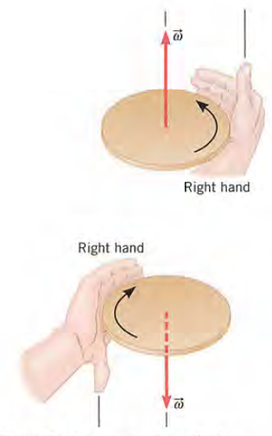
04-06 Angular Momentum
Direction of angular quantities
  Right-hand Rule
  Hold hand out with thumb out along axis
  Curl your fingers in direction of motion (you may have to turn your hand upside down)
  vector in direction of thumb

Slide 50
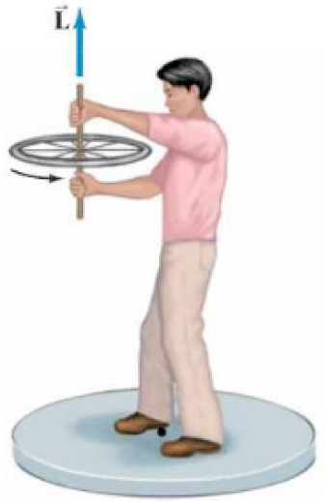
04-06 Angular Momentum
A person is holding a spinning bicycle wheel while he stands on a stationary frictionless turntable. What will happen if he suddenly flips the bicycle wheel over so that it is spinning in the opposite direction?
Notes:
Consider the system of turntable, person, and wheel. The total angular momentum before is L upward. Afterward, the total angular momentum must be the same. If the wheel is upside down, its angular momentum is –L so the angular momentum of the person must be +2L. So the person rotates in the direction the wheel was initially spinning.

Slide 51
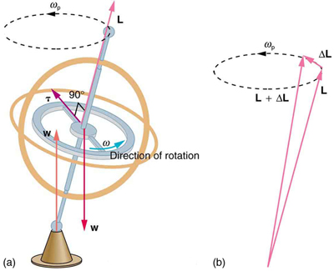
04-06 Angular Momentum
Gyroscopes
Two forces acting on a spinning gyroscope. The torque produced is perpendicular to the angular momentum, thus the direction of the torque is changed, but not its magnitude. The gyroscope precesses around a vertical axis, since the torque is always horizontal and perpendicular to L .
If the gyroscope is not spinning, it acquires angular momentum in the direction of the torque ( L = ΔL ), and it rotates around a horizontal axis, falling over just as we would expect.
Notes:
Use right-hand rule to find direction of torque.
Earth itself acts like a gigantic gyroscope. Its angular momentum is along its axis and points at Polaris, the North Star. But Earth is slowly precessing (once in about 26,000 years) due to the torque of the Sun and the Moon on its nonspherical shape.

Slide 52
04-06 Homework
Let you momentum carry you through these problems

